Slide 1


CREATING A SECURITY CULTURE TOGETHER
WITH DASHLANE
05.24.2021

Slide 2



Speaker Name
Speaker Title
WELCOME!
Notes:
Speaker introduces themselves, provides welcoming / opening thoughts
Thanks for joining today, we’re looking forward to sharing some insights with you around building a culture of security in your organization using password managers and cybersecurity best practices.

Slide 3


THE CYBERSECURITY LANDSCAPE
Chapter One
Notes:
Let’s start with a lay of the land. As a lot of you must experience, the landscape of cybersecurity is constantly changing.

Slide 4



















IAM 101
CYBERSECURITY IS A
PRIORITY AND A BARRIER.
IT’S COMPLICATED :)
CHAPTER ONE
80% of organizations have accelerated their digital transformation efforts
At the same time, data privacy and security are the top barriers to transformation
Despite investing in cybersecurity, nearly 3000 publicly disclosed breaches exposed 36 billion records during the first three quarters of 2020
Notes:
And while better cybersecurity measures are a priority for many organizations, they’re also a barrier to growth. Mostly because keeping up with data privacy and security standards can be a moving target, especially when an organization has accelerated their broader digital transformation efforts.

Slide 5


IAM 101
CHANGE IS THE ONLY
CONSTANT WHEN IT COMES
TO CYBERCRIMINALS,
BUT PASSWORD MANAGEMENT
CAN HELP
CHAPTER ONE
Threats are everywhere,
and cybercriminals are notoriously adaptable
Passwords are the
path of least resistance
for cybercriminals
Implementing a password manager helps address security and protect business
Notes:
Threats from cybercriminals are constant, and for them, passwords are the path of least resistance into an organization’s protected resources. Why break in when you can use a password to get in? Implementing a password manager is a great way to get ahead of this.

Slide 6





IAM 101
WHY YOU NEED A
PASSWORD MANAGER
61%
who admit to circumventing their company’s security protocols say they do it because it’s the most effective way to do their work.
CHAPTER ONE
Remote work is the new standard
BYOD culture is on the rise across enterprises
Shared networks and cloud computing
are the standard
The regulatory environment is constantly changing
SOURCE: SECURING USER DEVICES AND DATA IN THE AGE OF DIGITAL BUSINESS,”
DELL TECHNOLOGIES, 2019
Notes:
A password manager is timely, too: the way we live and work has changed, with more employees working remote or on their personal devices. Our use of shared networks and cloud computing complicates the security issue, not to mention a changing regulatory environment. But perhaps most importantly, password management makes an employee’s life easier: 63% of employees who admit to circumventing security protocols say they do it to be more effective. A password manager can fix that.

Slide 7



IAM 101
NET NET: PASSWORD MANAGERS HELP IMPROVE SECURITY WITHOUT DISRUPTING THE WORKDAY
CHAPTER ONE
Notes:
Simply put, password managers make work safer and easier for employees and for businesses.

Slide 8
IT’S ALL
ABOUT PEOPLE
Chapter Two
Notes:
Adopting a password manager starts with people, and with bringing employees on-board as guardians of your organization’s security.

Slide 9


IAM 101
OUR PERSONAL LIVES
AND PROFESSIONAL LIVES ARE BLURRING.
AND OUR PASSWORD CONVENTIONS ARE, TOO.
CHAPTER TWO
An employee’s digital identities are always intertwined
92% of IT decision-makers concerned about employees reusing personal credentials for work purposes
Notes:
Employees increasingly live one digital identity, moving between personal and professional resources. As a result, they often reuse credentials. This fact isn’t lost on IT: in a recent study, 92% cite their concern about employees reusing personal credentials for work purposes.

Slide 10
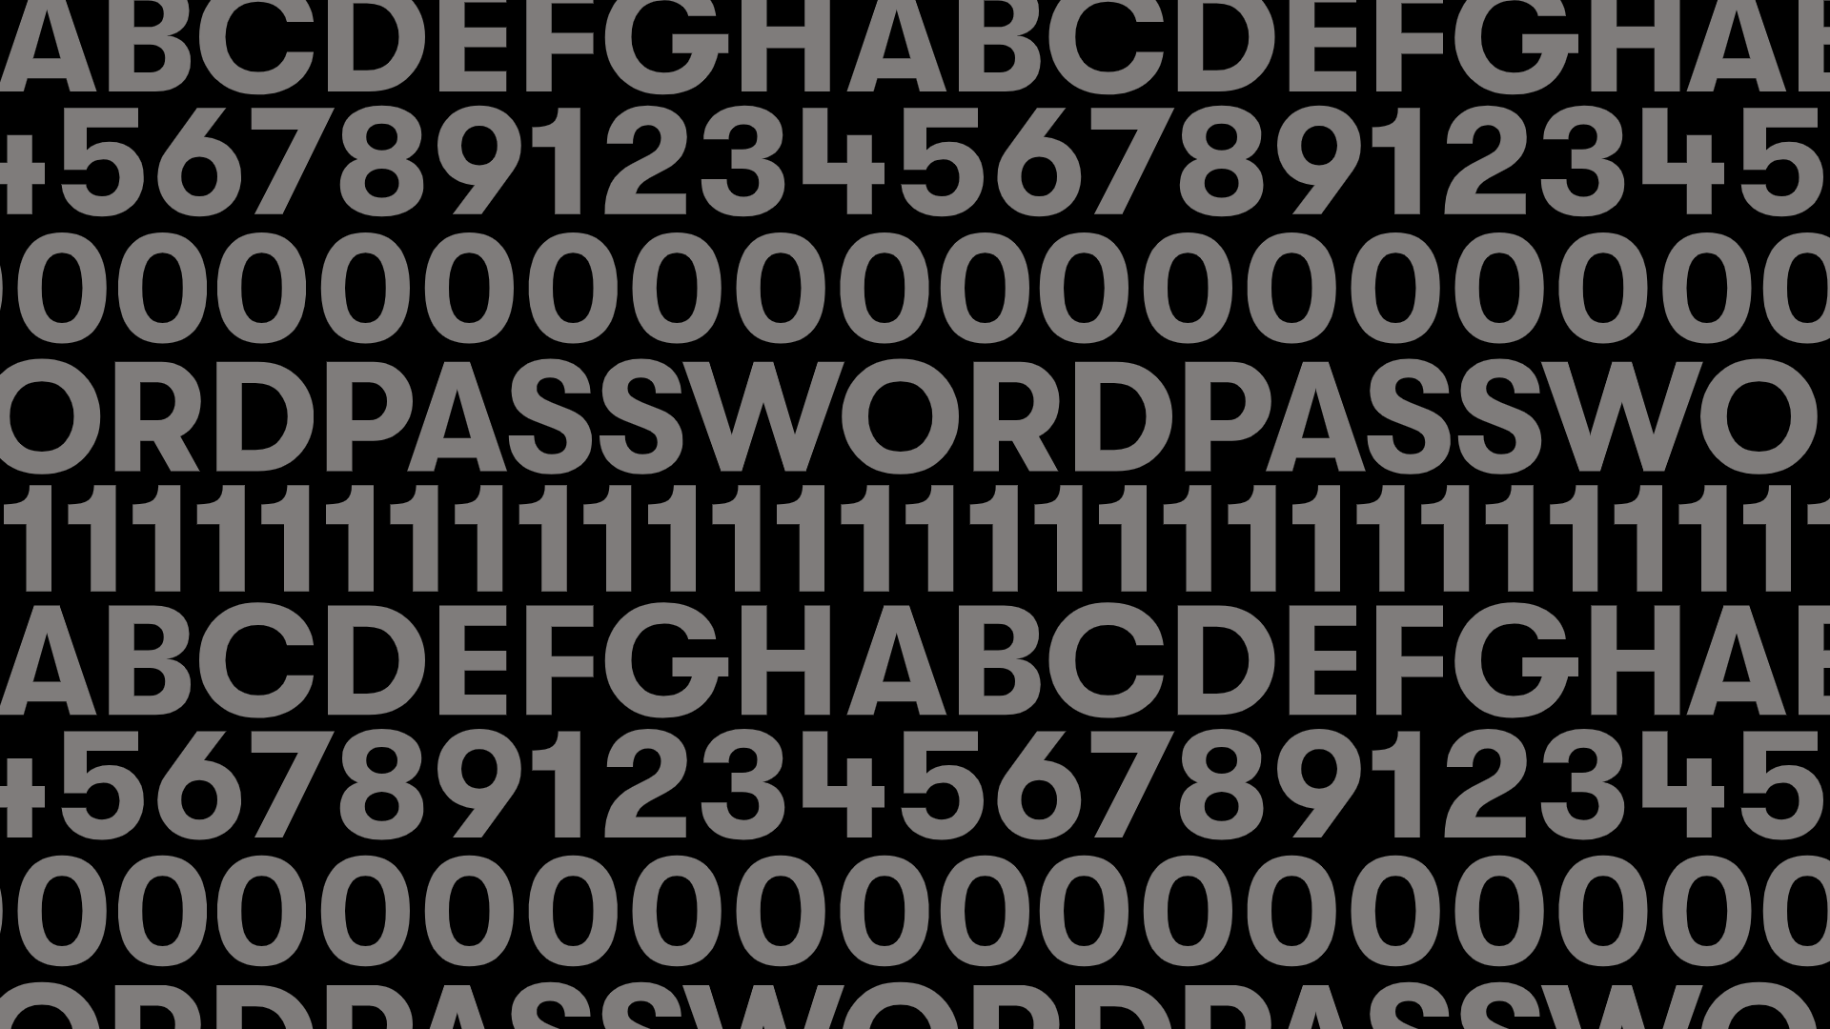

IAM 101
COMMON PASSWORD PITFALLS
Sharing among colleagues in unsecure ways
CHAPTER TWO
Using weak, easy-to-hack passwords
Storing passwords in web browsers
Notes:
Employees have often learned to lean on password habits that are … less than secure. From sharing passwords in an unsecure way, to using weak passwords, to storing passwords in web browsers, all of these can contribute to a potential breach.

Slide 11
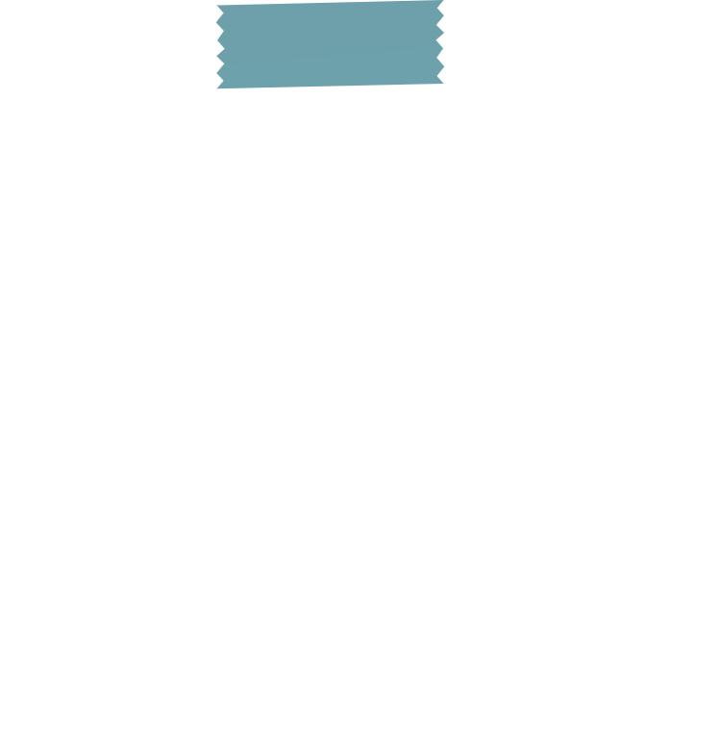
IAM 101
PASSWORDS + STICKY NOTES
= DISASTER?
41%
Ask Hawaii’s Emergency Management Agency. In 2018, the agency became famous after it broadcasted a false missile warning to islanders, which it blamed on an employee who pushed a wrong button.
Shortly after, however, a newspaper photograph from several months before came into the spotlight: It showed an operations officer from the company—and a sticky note with a legible password in the background.
While there’s no evidence that the photographed password contributed to the missile alert, the agency’s reputation suffered and its security practices came into question.
CHAPTER TWO
of individuals write down
their passwords
SOURCE: “THE 2020 STATE OF PASSWORD AND AUTHENTICATION
SECURITY BEHAVIORS REPORT,” PONEMON
Notes:
[Read through Hawaii EMA case] Sticky notes may not be to blame here, but they certainly leave organizations vulnerable; especially considering that 41% of people write down their passwords.

Slide 12


IAM 101
EMPLOYEES WANT TO BE PART
OF THE SOLUTION
79%
Help them understand their impact
CHAPTER TWO
of respondents said they take some personal responsibility for the company’s overall security
Educate them on best practices
Give them tools to make it easy
SOURCE: “THE 2020 STATE OF PASSWORD AND AUTHENTICATION SECURITY BEHAVIORS REPORT,”
PONEMON
Notes:
But the good news is, employees want to be part of the solution. According to a recent study conducted on behalf of Dashlane by the Harris Poll, 79% or respondents said they take some personal responsibility for the company’s overall security. So how do you make that happen? By helping them understand their impact, educating them on best practices, and giving them tools to easily improve.

Slide 13





IAM 101
DASHLANE MAKES PASSWORD MANAGEMENT SIMPLE
CHAPTER TWO
We’ve helped over 15 million users and over 20,000 companies in 180 countries to dash across the internet without compromising on security.
Admins can easily onboard, offboard, and manage their employees with the assurance that company data is safe.
Employees can be part of the answer, enjoying a way to manage their work and personal accounts.
Notes:
At Dashlane, this is what we do, all day every day. Helping bring secure access to organizations across the globe, removing the burden of security and access, and making employees a bigger part of their organization’s cybersecurity story.

Slide 14

PASSWORD HEALTH: IMPROVING PASSWORDS
AND MONITORING PROGRESS
Chapter Three
Notes:
A culture of security starts with great password hygiene and active monitoring of your organization’s progress. Dashlane provides shareable insights that can help you improve.

Slide 15

Password Health
IMPROVING YOUR BUSINESS’S PASSWORD
HYGIENE WITH
PASSWORD HEALTH SCORE
CHAPTER THREE
Measures the strength (or vulnerability) of employee passwords
Illustrates possible threats and protects against password-related attacks
Notes:
Your business’s password health improves when you’re able to actively measure the strength (or vulnerability) of employee passwords in real time; and when you can understand threats and protect against password related attacks. Password Health Score is a feature that helps you keep your business secure

Slide 16

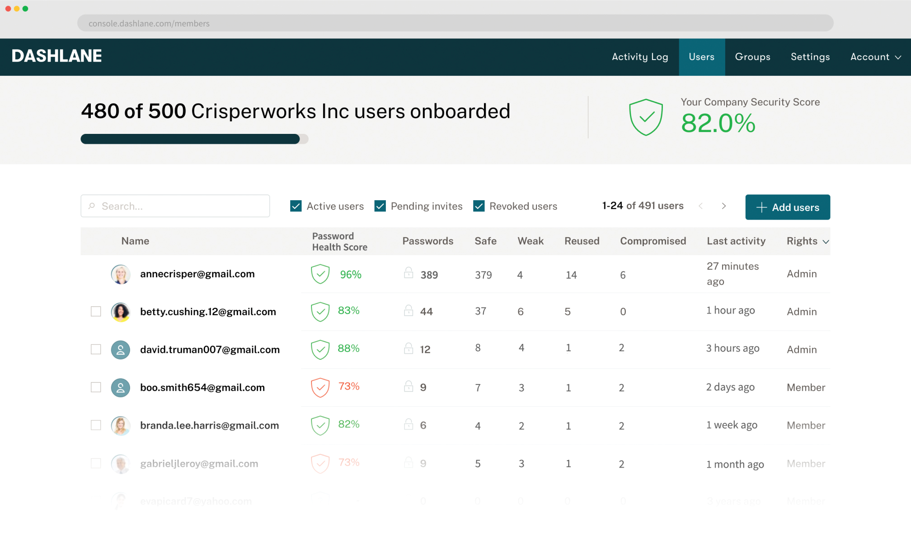
Password Health
AT A GLANCE
PASSWORD HEALTH
CHAPTER THREE
Shows number and breakdown of accounts with weak, reused or compromised passwords
Helps prioritize critical accounts that need password changes
Makes it easy to replace passwords with link to account website
Notes:
So let’s look at what Password Health is. The features shows the number of accounts with weak, reused or compromised passwords; it identifies specific data breaches related to passwords; it helps prioritize accounts that need to change their password; and it makes easy to replace passwords with links to account websites.

Slide 17






Password Health
PASSWORD HEALTH =
ASSURANCE FOR EMPLOYEES + VISIBILITY FOR ADMINS
CHAPTER THREE
Dynamic reporting features
View current and past Password Health Score
Benchmark company security and view future trendlines
See total compromised passwords saved for each employee
Notes:
Password Health is a win for employees and admins, giving you assurance and visibility into your current password health, your future trendlines, and your real-time progress against goals.

Slide 18
Password Health
FIVE WAYS TO USE DASHLANE’S PASSWORD HEALTH FEATURE
Set a goal for individual employee scores and the overall company score. We recommend 90.
Encourage employees to watch for the alerts that Dashlane sends whenever a new data breach exposes their accounts.
CHAPTER THREE
Use Password Health as an internal awareness tool. Educate employees about the risks of compromised, weak, and reused passwords, both to their personal lives and your company’s security.
Monitor changes in Password Health over time to gauge the success of your security and awareness campaigns, and use this insight as a north star in company townhall presentations or executive briefings.
Create incentives for high-risk employees—those with low scores and reused personal and business passwords—and reward improvements.
Notes:
So how do you use the Password Health feature? Here are five ways. [READ SLIDE CONTENT]

Slide 19
MONITOR THE DARK WEB FOR COMPROMISED CREDENTIALS
Chapter Four
Notes:
Password Health helps you keep your eyes on your organization, but what about monitoring the dark web?

Slide 20
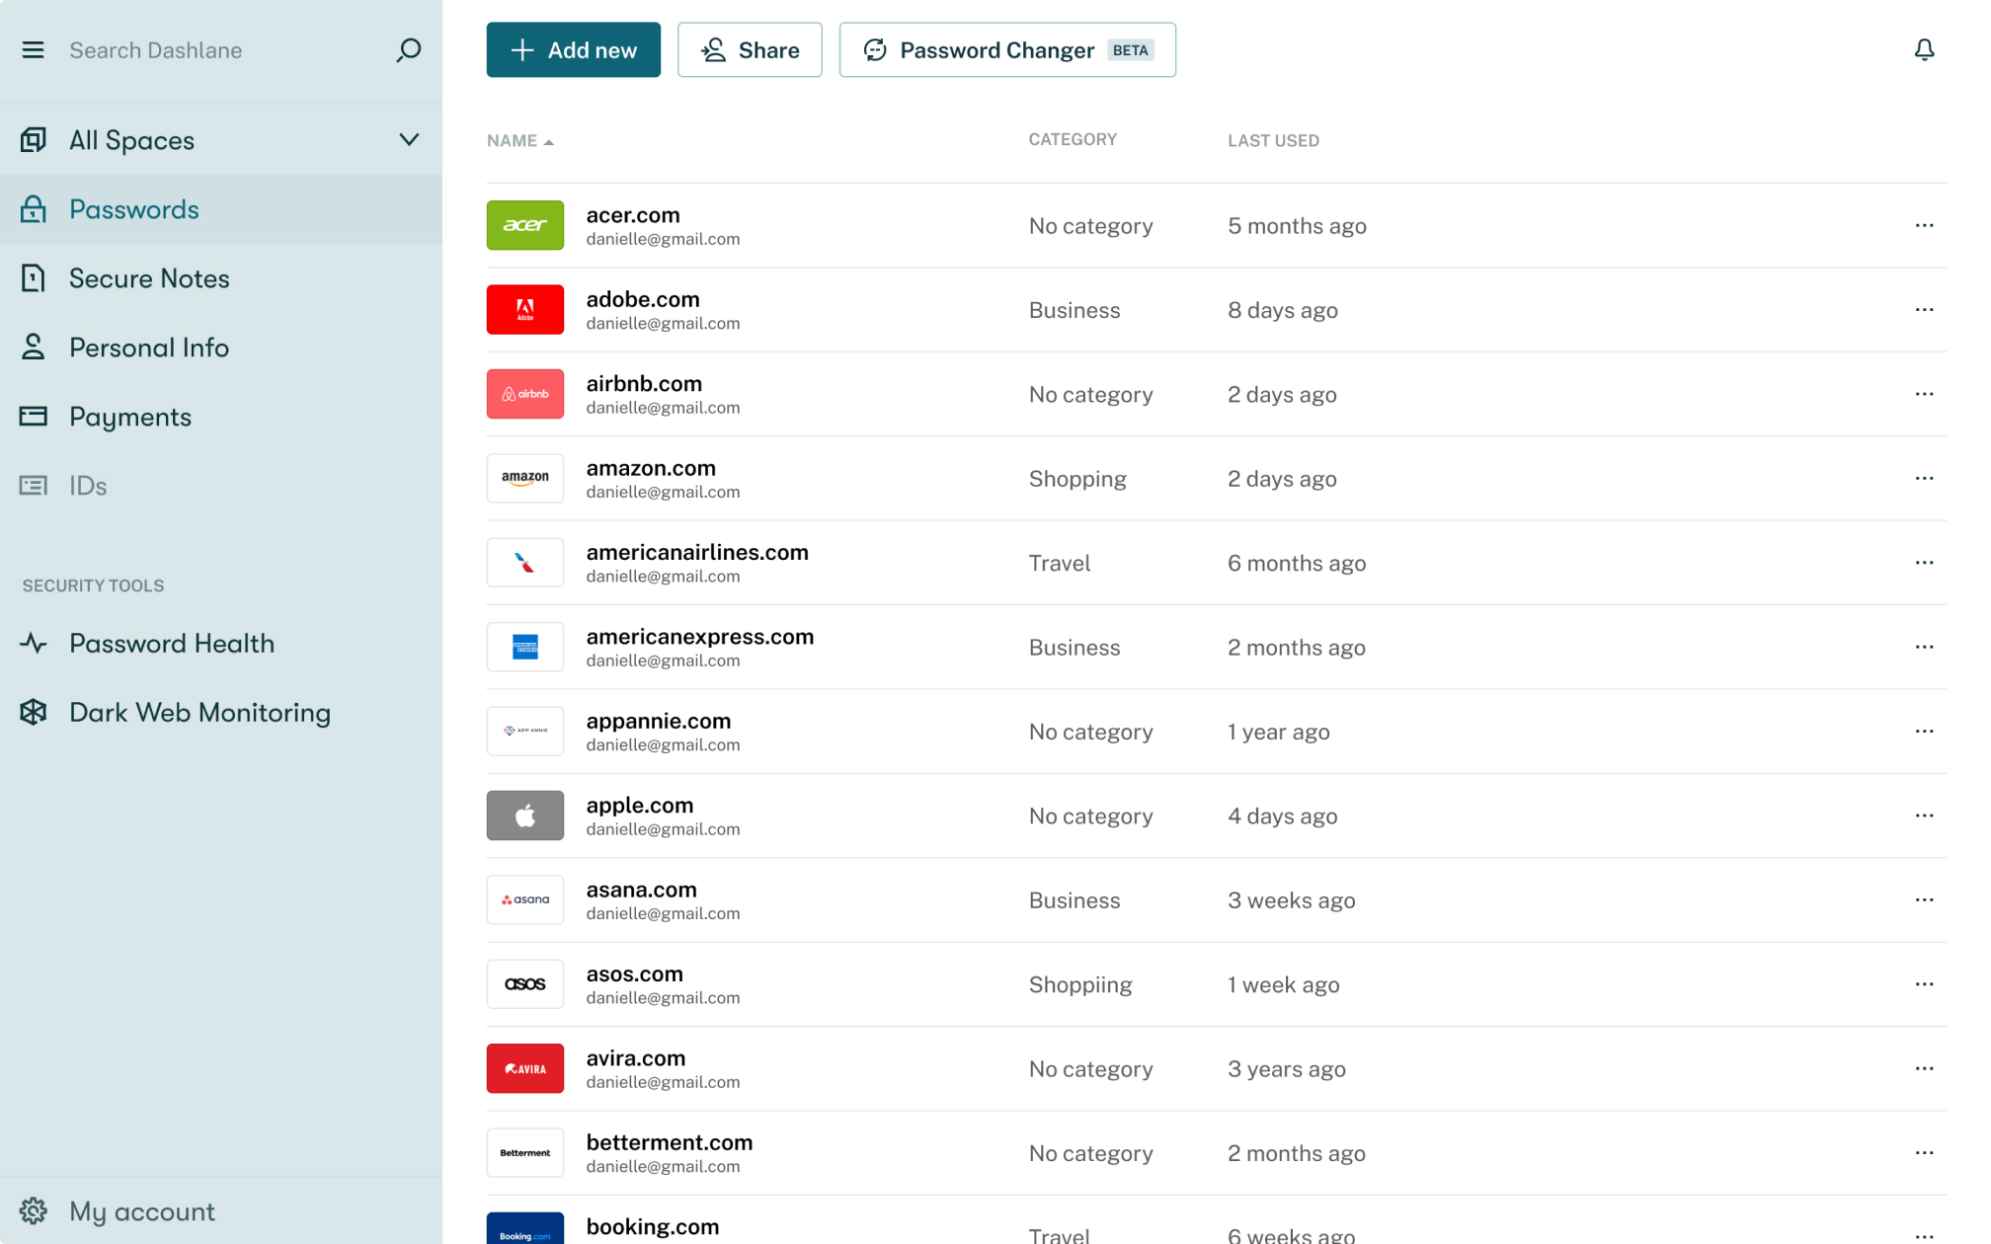
AT A GLANCE DARK WEB MONITORING
Monitor the dark web for compromised credentials
Available to all users on a business plan
Alerts employees when their information appears on the dark web
How it works
Employee adds up to five email addresses
CHAPTER FOUR
Dashlane scans billions of accounts on dark web and flags exposed accounts
Employees can take action by clicking on button for flagged credential, which takes them to a login page to change their password; Dashlane
Employees can take action by clicking on button for flagged credential, which takes them to a login page to change their password; Dashlane Generator creates a strong, random password
Notes:
Dashlane’s Dark Web Monitoring Feature alerts employees when their information appears on the dark web. They can add up to five email addresses to monitor, and then Dashlane scans billiions of accounts on the dark web to uncover exposed accounts. From there, employees can take action by clicking on button for flagged credential, which takes them to a login page to change their password; Dashlane Generator creates a strong, random password
Dashlane continues to scan dark web for personal or financial info and breaches

Slide 21





BETTER TOGETHER:
PASSWORD HEALTH
AND DARK WEB
MONITORING
Monitor the dark web for compromised credentials
CHAPTER FOUR
Features work together to empower
employees to take action
Both features drive up Password Health Score
Notes:
Password Health and Dark Web Monitoring work best together, and they both can actively drive up your organization’s Password Health Score.

Slide 22

BUILDING A SECURITY CULTURE DOESN’T HAVE TO SUCK
Chapter Five
Notes:
In all seriousness, a security culture that engages employees can actually be really refreshing and easy to maintain.

Slide 23

IAM 101
THREE STEPS FOR CREATING
A CULTURE OF SECURITY
Track progress over time
Check your reporting dashboard weekly to see real-time updates on your company’s score. You’ll also be
able to monitor which employees are taking action and which aren’t.
CHAPTER FIVE
Lower risk of data breaches
Send an email to the entire company explaining your objective, why it’s important, and what you’d like employees to do.
Adjust based on results and follow up
Revise your tactics based on the weekly progress. This may include sending follow-up emails or jumping on your internal communication platform (like Slack). Provide updates, display progress, and nudge stragglers to change their passwords. And if you’re not seeing the desired outcomes, discuss other strategies with your team.
Notes:
And what’s more, creating a culture of security can be easy. Here are three simple steps to get started.
First, raise awareness! Education is huge, and it can be as simple as sending out an email to employees asking them what to do and explaining why their contribution matters.
Second, track your progress over time and you’ll be able to see which employees aren’t taking action. From there, you can revise your strategies to engage more and more employees in your cybersecurity efforts.

Slide 24


IAM 101
Case study
HOW KHM TRAVEL GROUP BUILT A SECURITY CULTURE WITH DASHLANE
With Dashlane, KHM Travel:
Empowers employees to take charge of their own online security by improving their Password Health Scores
CHAPTER FIVE
Knows that employees are aware of new data breaches, thanks to automatic Dashlane alerts
One of the most innovative host travel agencies in the United States, KHM Travel Group supports more than 4,500 independent travel agents. The company deployed Dashlane to make password management, as well as employee onboarding and offboarding, easier and less disruptive. In addition to achieving those goals, implementing Dashlane helped KHM Travel Group foster a culture of security awareness.
Has changed the way the entire company thinks about security—using Dashlane to springboard into security awareness and making security part of everyone’s responsibility

Slide 25
IAM 101
Case study
HOW SHEEHAN NAGLE HARTRAY ARCHITECTS LEVELED UP SECURITY WITH DASHLANE
It wasn’t long before the team began to see improvements in SNHA’s cybersecurity posture, thanks to a variety of Dashlane’s features including:
Password Generator
CHAPTER FIVE
Secure sharing
Sheehan Nagle Hartray Architects (SNHA) is a leading full-service architectural firm that, until recently, was faced with several cybersecurity challenges — particularly poor password habits. Not only did this leave the organization vulnerable to theft, but the sheer number of credentials was becoming too difficult to manage. The SNHA team turned to Dashlane for help managing their passwords securely — and ramping up quickly.
Password Health Score and accompanying reporting dashboard
One key result?
A 20% increase in the firm’s Password Health Score in less than seven months.
Notes:
https://blog.dashlane.com/case-study-epromos/

Slide 26

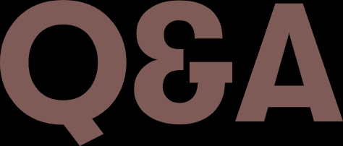


Slide 27

Thank you!
DASHLANE.COM
SPEAKEMAIL@DASHLANE.COM

